Slide 1


Green Pace
Security Policy Presentation
Developer: Robert Cook
Notes:
Hello everyone, my name is Robert Cook. Today we are going to go through a presentation on a new security policy for Green Pace that will provide guidelines for implementation and notes for maintaining it in the future.

Slide 2

OVERVIEW: DEFENSE IN DEPTH
Purpose
Address issues in code development and the architecture of the system.
Give clear guidelines to enforce secure coding practices.
Strategy for Defense-in-Depth
Ensure policy follows model of defense-in-depth to protect against vulnerabilities.
Notes:
This policy aims to address vulnerabilities in both software development and system architecture. By adopting standardized secure coding practices, we can minimize the risks of vulnerabilities like SQL injection and buffer overflows. Our defense-in-depth strategy involves layered security measures, including code-level protections like input validation and encryption, and system-level measures like network and endpoint security. Each security layer enhances overall defense, as depicted in the interconnected diagram.

Slide 3
THREATS MATRIX
Likely STD-002-CPP (Buffer Overflow) High Likelihood due to improper input validation. | Priority STD-003-CPP (SQL Injection): High priority because SQL Injection can lead to data leaks, Must be mitigated with prepared statements.
Low priority STD-007-CPP (Error Handling): Lower priority than SQL Injection or Buffer Overflow but still important. | Unlikely STD-009-CPP (Resource Management): Unlikely but needed for stability.
Notes:
The Threats Matrix sorts risks by their likelihood and priority. Certain threats, such as buffer overflows and SQL injection, are both high-likelihood and high-priority due to their impact. Conversely, resource management and error handling are lower on the priority scale. This matrix helps us focus efforts on vulnerabilities most likely to occur and have severe consequences.

Slide 4
10 PRINCIPLES
Validate Input Data
Applies to Coding Standards such as Input Validation (STD-008-CPP) to ensure no unverified data can enter the system.
Heed Compiler Warnings
Related to standards like Memory Protection (STD-005-CPP), as compilers often flag potential memory leaks.
Architect and Design for Security Policies
Applies to standards like SQL Injection Mitigation (STD-004-CPP), where secure architecture prevents attacks.
Keep It Simple
Relevant to standards like Error Handling (STD-009-CPP), making error paths straightforward and predictable.
Default Deny
Supports Authorization policies under the Triple-A Framework, ensuring access is granted explicitly.
Adhere to the Principle of Least Privilege
Ensures compliance with SQL Injection (STD-004-CPP) by limiting database privileges.
Sanitize Data Sent to Other Systems
Applies to String Handling (STD-003-CPP) to prevent malicious data from being transmitted.
Practice Defense in Depth
Relevant to all coding standards, ensuring multiple levels of validation and checking are present.
Use Effective Quality Assurance Techniques
Applies to Exception Handling (STD-007-CPP) and other standards where quality assurance helps ensure reliable error handling.
Adopt a Secure Coding Standard
The foundation for all coding standards mentioned in the presentation, ensuring security is maintained consistently.
Notes:
The following ten core principles guide our security policy. Each principle is aligned with coding standards to enforce best practices throughout development. For instance, "Validate Input Data" aligns with standards aimed at preventing buffer overflows and SQL injections. Similarly, "Heed Compiler Warnings" ensures that flagged vulnerabilities are caught during the early stages of coding.

Slide 5
CODING STANDARDS
SQL Injection- High
Buffer Overflow (STD-002-CPP)- High
Data Type Misuse (STD-001-CPP)- High
Input Validation (STD-008-CPP)-High
Memory Leaks (STD-005-CPP)- Medium
Assertion Misuse (STD-006-CPP)- Medium
Error Handling (STD-007-CPP)- Medium
Resource Management (STD-009-CPP)- Medium
String Correctness (STD-004-CPP)- Low
Error Reporting (STD-010-CPP)- Low
Prioritization:
High- Critical vulnerabilities.
Medium- Performance and stability issues.
Low- Not critical but needed for security compliance.
Notes:
Coding standards are categorized by the severity and potential impact of vulnerabilities. High-priority issues, such as SQL injection and buffer overflow, are addressed first due to their significant security risks. Medium-priority standards focus on stability and resource management, while lower-priority items such as string correctness are less urgent.

Slide 6
ENCRYPTION POLICIES
Encryption in Flight:
Data must be encrypted during transmission (in Flight) using protocols like Transport Layer Security (TLS) or Secure Sockets Later (SSL). This prevents interception of data as it travels between systems, APIs, or servers. This applies to all communication between internal systems, client-server connections, and data exchanged over the internet.
Encryption at Rest:
Sensitive data must be encrypted before being stored (at Rest). This will ensure that it remains secure even if the physical storage becomes compromised. We can use strong encryption like AES-256 to ensure that all customer data is secured. This includes customer data, internal records, and backups.
Encryption in Use:
Techniques like hardware-based memory encryption or trusted execution environments are used to secure sensitive data during processing (in Use). This ensures that the data remains protected when it is being used for operations such as analysis or calculations. This is very important for applications that involve personal data, financial transactions, or other sensitive information that is being computed in real time.
Notes:
Our encryption strategy targets three primary areas: data in transit, data at rest, and data in use. For data in transit, we utilize protocols like TLS/SSL to ensure security during transmission. Encryption at rest applies strong algorithms to secure stored data, while encryption in use safeguards data being processed in memory. Combined, these measures protect data confidentiality and integrity at all stages.

Slide 7
TRIPLE-A POLICIES
Authentication
Verifies User identity
Requires the use of multi-factor authentication (MFA)
Authorization
Determines what the user or system can access based on credentials
Follows principle of least privilege to ensure users only have access to what they need.
Accounting
Logs and monitors all actions performed by users and system access.
Ensures that logins, file access, and system changes are logged for audit purposes.
Notes:
The Triple-A framework encompasses authentication, authorization, and accounting. Authentication confirms user identities using strong methods like multi-factor authentication. Authorization manages access based on user roles, adhering to the principle of least privilege. Accounting monitors user activities and system access, creating a trail for security audits. Together, these policies help secure access and ensure accountability.

Slide 8
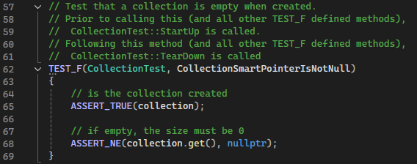
CollectionSmartPointerIsNotNull
Notes:
Now, let's examine one of the unit tests created to validate the security and stability of the system. This specific unit test aims to verify that the smart pointer for a collection is properly initialized at the time of its creation. We utilize the GoogleTest framework for this test. The ASSERT_TRUE macro checks whether the collection object was successfully instantiated, confirming that it is not null. The ASSERT_NE macro then ensures that the smart pointer within the collection is not equal to nullptr, verifying that it points correctly to the collection instance.
If this test passes, it confirms that the collection is initialized correctly and does not have null references when empty. Ensuring that smart pointers are correctly initialized helps prevent null pointer dereference errors, which could lead to crashes or unpredictable behavior in our application.

Slide 9
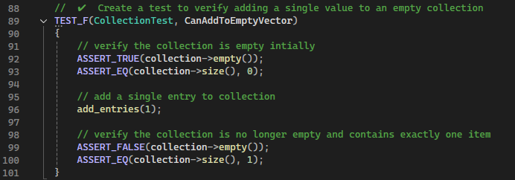
CanAddToEmptyVector
Notes:
This unit test verifies that adding an element to an empty collection is successful. Initially, we use ASSERT_TRUE to check that the collection is empty and has a size of zero. After adding an entry, we use ASSERT_FALSE to verify that the collection is no longer empty and ASSERT_EQ to confirm the collection's size is now one. This test confirms that the collection properly handles adding elements.

Slide 10
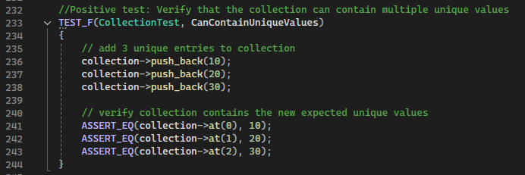
CanContainUniqueValues
Notes:
This unit test ensures that the collection can store multiple unique values and maintain their order. We use the push_back method to add values 10, 20, and 30, and use ASSERT_EQ to verify that the values are correctly stored at specific indices. This test confirms that the collection holds multiple distinct values and maintains the correct sequence.

Slide 11
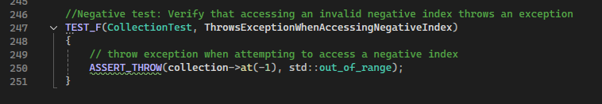
ThrowsExceptionWhenAccessingNegativeIndex
Notes:
This test checks whether the collection properly handles attempts to access an invalid negative index. We use the ASSERT_THROW macro to confirm that an out_of_range exception is thrown when calling the at(-1) method. This ensures that invalid operations are handled appropriately, preventing crashes or undefined behavior.

Slide 12

AUTOMATION SUMMARY
Notes:
This diagram illustrates how automation is incorporated into the DevSecOps pipeline. In pre-production, automation tools like static analysis and threat modeling catch vulnerabilities early. During testing, automated dynamic tests simulate attacks to verify security. In production, continuous monitoring tools log and detect threats in real time. Post-production, automated incident response tools isolate threats and restore secure states. Automation ensures security integration throughout every stage.

Slide 13
TOOLS
Pre-Production
Static Code Analysis finds early vulnerabilities.
Compiler enforces security protocols during code compiling.
Verify and Test
Dynamic Testing checks for runtime vulnerabilities.
Fuzz Testing creates random inputs to find input validation problems.
Production
Monitoring tools track the system for potential threat activity.
Log Analysis finds unusual patterns indication suspicious behavior.
Post-Production
Incident Response isolates threats and initiates recovery.
Notes:
In the pre-production phase, automation begins with threat modeling and static analysis during the design and build stages, allowing vulnerabilities to be identified early. During testing, automated dynamic testing is used to simulate potential attacks and validate the application’s security before deployment. In the production environment, continuous monitoring tools detect and log potential threats automatically, ensuring ongoing system security. Post-production involves using automated incident response tools to isolate and mitigate threats, restoring the system to a secure state with minimal disruption. By integrating automation at every stage, we maintain a strong security posture throughout the entire lifecycle.

Slide 14
RISKS AND BENEFITS
Problems
Lack of Early Security Measures
Limited Automation
Solutions
Implementing Secure Coding Standards
Automated Security Tools
Risks of Waiting
Increases likelihood of vulnerabilities going undetected.
Costs more if a breach happens before measures are implemented.
Acting Now Benefits
Enhanced security by detecting threats sooner and having automation responses in place.
Reduces the risk of security problems and lowers the cost long term.
Notes:
Delaying security automation increases the likelihood of vulnerabilities and breaches. By integrating automated security tools now, we can reduce manual testing, improve overall security, and catch issues early. Waiting to implement these measures raises potential costs and risks, while acting now strengthens security posture, reduces long-term expenses, and optimizes development.

Slide 15
RECOMMENDATIONS
First Gap- Lack of Continuous Integration Security Checks
Fix: Implement automated security tests in the pipeline.
Second Gap- Limited Coverage of Input Validation
Fix- Expand framework for Input Validation to cover all points of entry and integrate fuzz testing to find unexpected inputs.
Third Gap- Insufficient Automation for Incident Response
Fix- Add in advanced incident response tools to automate the containment and mitigation. This will reduce the time it will take to respond to any breaches.
Notes:
Despite strong security measures, there are areas for improvement. Implementing security tests in the continuous integration pipeline will automatically detect vulnerabilities with every change. Expanding input validation coverage and adding fuzz testing will further enhance resilience. Increased automation in incident response will also allow quicker threat mitigation.

Slide 16
Standards to Prevent Future Problems
Implement Secure Coding Standards
Widen the use of secure coding standards like SEI CERT and OWASP to cover more areas of development.
Enhance Threat Modeling and Risk Assessment
Use automated threat modeling tools to assess risks regularly due to threats evolving. This can help to make your system more adaptive.
Implement Continuous Security Education
Provide training for developers and operation teams regularly on the newest security risks and strategies on defense to keep up with any new developing threats.
Notes:
To stay ahead of emerging risks, adopting more detailed secure coding standards will be essential. Enhancing threat modeling and risk assessment will make our system more adaptable to new threats. Continued team training in the latest security practices will help ensure ongoing system resilience.

